Slide 1
Elgamal Signature with Invalid Random k
Project report - BCSE309L Cryptography and Network Security
By
Sandeep Ganesh (23BRS1076)
Subal V R (23BRS1393)
Arumuga Selvan (23BRS1317)

Slide 2
Abstract
Elgamal digital signature scheme is a classical public-key cryptographic mechanism
Strength of this algorithm - computational hardness of the discrete logarithm problem.
Weakness of this algorithm – choosing invalid ephemeral key or reusing the key.
Ppt explains the work done on exploring the failure of the Elgamal’s Digital Signature Scheme when using invalid ephemeral key (‘k’).

Slide 3
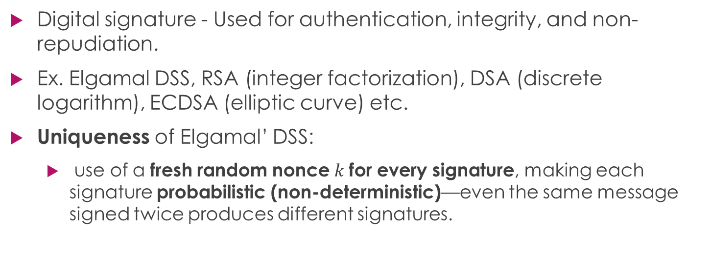
Elgamal Signature Scheme - Introduction
Digital signature - Used for authentication, integrity, and non-repudiation.
Ex. Elgamal DSS, RSA (integer factorization), DSA (discrete logarithm), ECDSA (elliptic curve) etc.
Uniqueness of Elgamal’ DSS:
use of a fresh random nonce $k$for every signature, making each signature probabilistic (non-deterministic)—even the same message signed twice produces different signatures.

Slide 4
Basic requirements
Each signature must use a fresh k.
Value of ‘k’ should be such that gcd(k, p-1) =1, so that k⁻¹ (modular inverse of k) exists.
Effects of using invalid ‘k’:
The signing process may fail because the inverse does not exist
it may produce signatures that behave unpredictably and open the door to forgery
The system becomes unreliable.

Slide 5
Project insight
Implementation of Elgamal signature scheme in Python
Allowing invalid ‘k’ to observe failures
Reusing ‘k’ to find out the gaps
Adding validation and generating report

Slide 6
Mathematical Insight
Variables:
p-prime num, g- generator, x-private key, y=public key, k-ephemeral key, H(M)-Hash of the Message M
Assumptions:
given gªmod p, a cannot be found in polynomial time
The hash function is collision-resistant

Slide 7
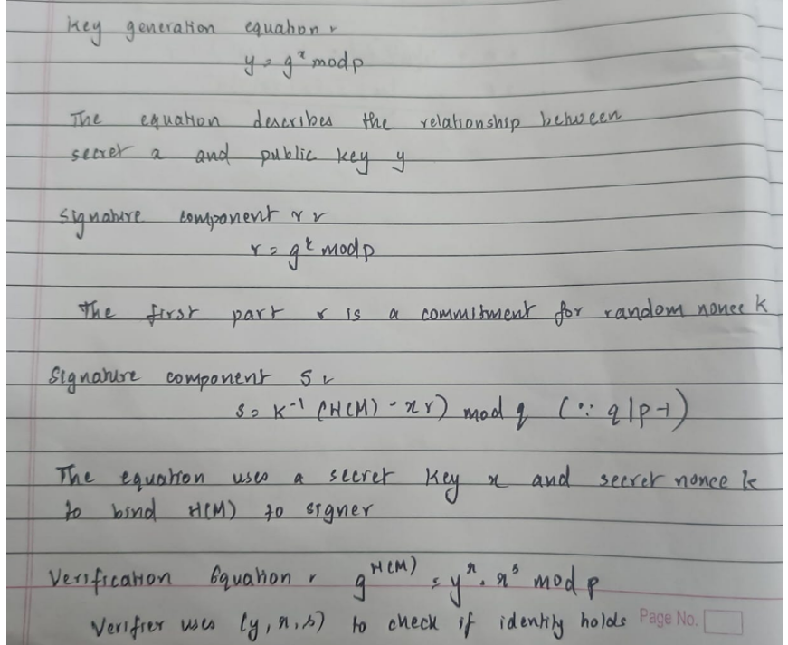
Mathematical insight
Equations used:

Slide 8
Mathematical analysis
Signature Generation – converts primary key x and message hash H into verifiable signature pair (r,s)
Choose random k such that 1 < k < p-1
Compute r = g^{k} (mod p)
Compute s =k⁻¹ (H(M) – xr) (mod q) (such that q is a subgroup of p-1)
The inverse k⁻¹ exists if and only if gcd (k, q) =1. Without invertibility, solving for s is no longer guaranteed.

Slide 9
Mathematical Analysis – proof 1
Failure when gcd (k, q) != 1
Number theory states that, as ≅ b(mod n) has a solution if and only if gcd (a,n) | b.
Here: a=k n=p-1 b=H(M) – xr q → q | (p-1) ➔ Thus, a solution exists only if d | H(M) – x
Case 1: d+ H(M) - xr - No solution exists. The signer cannot compute ‘s’. Authentication fails completely (Denial of Service condition)
Case 2: d|H(M) – xr - There are ‘d’ distinct solutions → leads to multiple possible ‘s’ values. The signature is weak and not unique.
Result:
if gcd(k, q) != 1, the signing equation
Has no solution
Has Multiple solutions

Slide 10
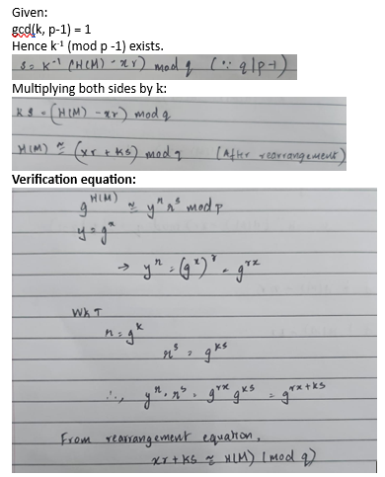
Mathematical Analysis – proof 2
Correctness When gcd(k, p-1) = 1

Slide 11
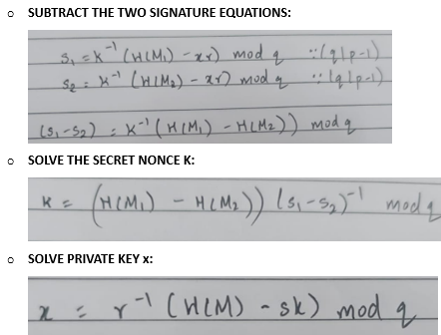
Mathematical Analysis – proof 3
Resued Nonce Attack:
Happens when the sender uses the same ‘k’ value to sign 2 different messages M1 and M2.
provides linear equations with two variables - can be solved using elimination method.

Slide 12
System Model
Entity | Role in the System | Key Responsibilities
Signer (Alice) | The Originator | Generates private key x and uses a unique random nonce k. This is used to compute the signatures (r,s).
Verifier (Bob) | The Validator | Uses signer’s public key y = g^{x}modp and verifies the signature
Key Generation Center (KGC) | Infrastructure | A large prime number p and g are selected according to cryptographic standards
Insecure Channel | Medium | Interception attacks are made possible as attackers can observe multiple signature and can use reused nonce attack if ephemeral key k is not unique

Slide 13
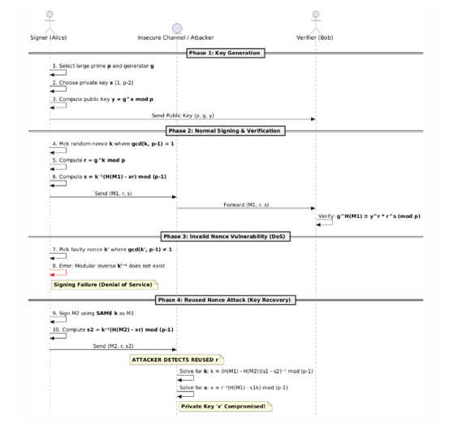
Attack Model
2 kinds of security risks are modelled:
The use of a non-coprime
random nonce k
Reuse of the nonce which is
coprime with q

Slide 14
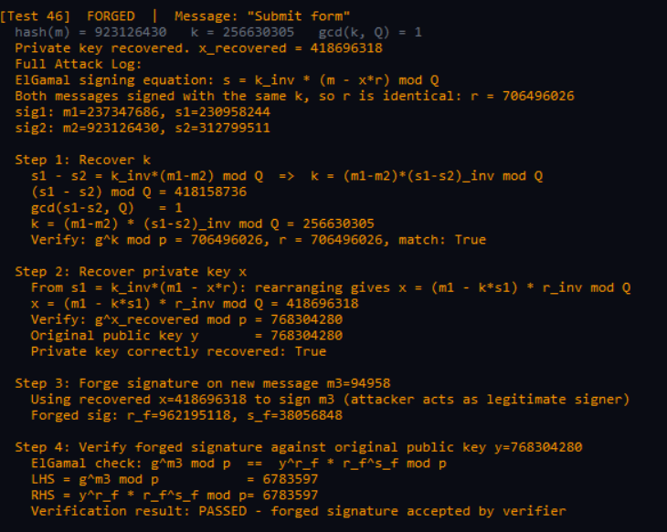
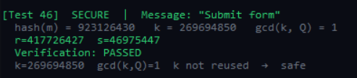
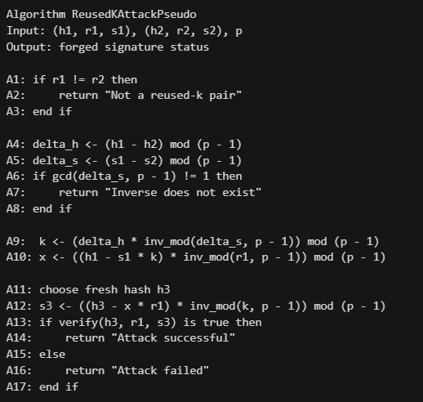
Implementation (screenshots)
Vulnerability attack
Prevention
Algorithm

Slide 15
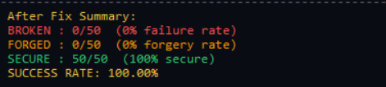
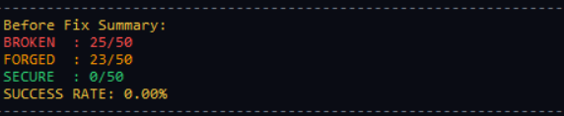
Results
gcd(k,q) == 1:
gcd(k, q) !=1:

Slide 16
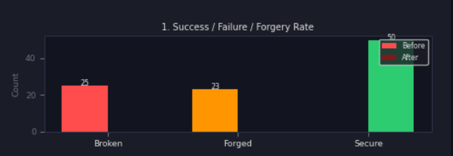
Graph-1
The system runs 50 testcases of insecure and 50 testcases of secure signatures. The bar graph has identified 25/25 broken testcases and 23/25 forged testcases before Fix.
After fix: all 50/50 testcases were secure i.e. use of unique k and checking gcd(k,q) = 1

Slide 17
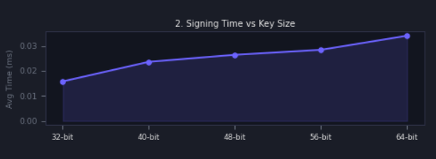
Graph-2
Average sign time increases from 0.015 ms in 32 bit key size to 0.03 ms in 64 bit key size. This tells that as we increase key size, signing time also increases.

Slide 18
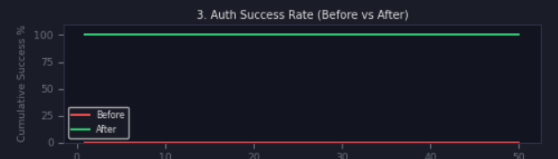
Graph-3
The system runs 50 testcases of insecure and 50 testcases of secure signatures. Before fix the authentication success rate is 0% and after fix it became 100%.

Slide 19
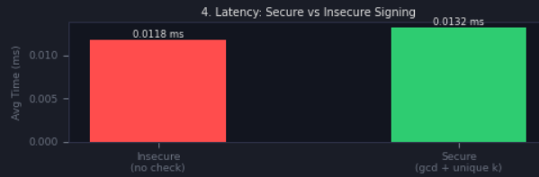
Graph-4
The system shows secure signing takes a slightly higher time than insecure cases. It adds a marginal latency of 0.0014 ms (0.0132 ms vs 0.0118 ms).

Slide 20
Constraints
Despite the improved success rates, the current implementation has specific constraints:
Scalability vs. Latency: As shown in the "Signing Time vs Key Size" graph, increasing bit-length leads to exponential growth in computational overhead.
Entropy Dependency: The security of the "Unique k" approach relies entirely on the quality of the Random Number Generator (RNG); low-entropy seeds can still lead to predictable keys.
Resource Constraints: The additional $gcd$ checks and validation logic, while marginal in these tests, may impact performance on low-power IoT microcontrollers with limited clock speeds.

Slide 21
Conclusion
By implementing the ‘gcd(k, q) =1’ requirement and ensuring uniqueness of the nonce key, , the system achieved a 100% Authentication Success Rate with a negligible latency increase of only 0.0014 ms.
While effective for the tested bit-lengths, future iterations must balance the increasing demand for higher bit-security with the linear rise in signing time to maintain optimal system performance.

Slide 22
Thank you

